Slide 1


Spatial patterns of air pollution as a probe for understanding environmental processing using public data.
Ziyi Wang
Supervised by Andrew Rate
2023-12-05/12

Slide 2
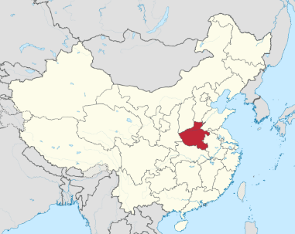
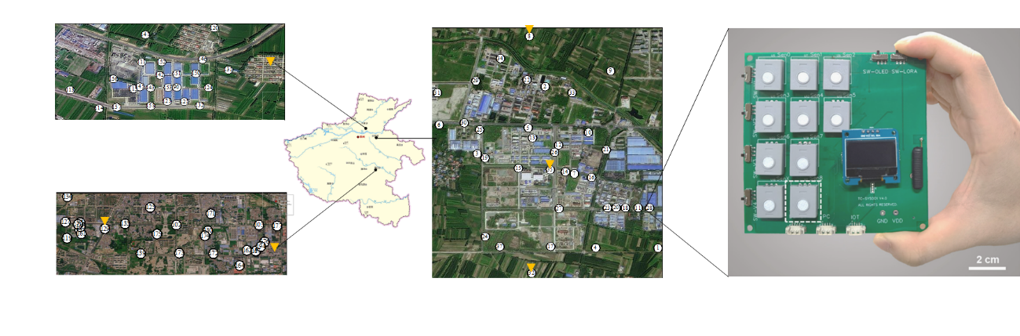
Study area in Henan
Plastic weaving park in XinXiang
0.6 km*0.5 km with 32 spots
Urban in ZhouKou
Chemical industrial park in KaiFeng
6.0 km*1.0 km with 27 spots
2.0 km*2.5 km with 36 spots

Slide 3
Data processing
Invalid data include
Redundant value that stays the same for a period of time
Data when temperature is lower than 10 ℃( not accurate, thats why they said winter data is not good)
When concentration 10 is 10000
Tips:
The order of processing:hourly--daily--mongthly
Because the number of data per hour is different, it is not accurate to directly average all values to find the day average, so we must first find the hour average and then calculate day average
Do not delete data rows directly, otherwise the data availability will be affected

Slide 4
Data distrubution
Data distribution
missing data in winter (3-7 am low temperature) temporarily
missing data for whole device
they dont affect overall presentation for whole site

Slide 5
Data discussion
local emission pattern
land use/governmental website
combining with wind speed device
seasonal difference (sta test)
coal burning
less sunslight less photochemical reaction
strong north/northwest wind in spring (kaifeng)
city difference
more detailed geological info/compare land use

Slide 6
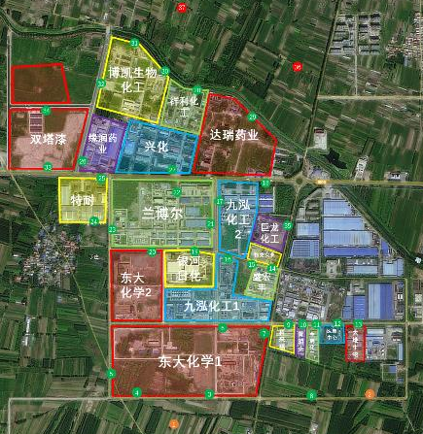
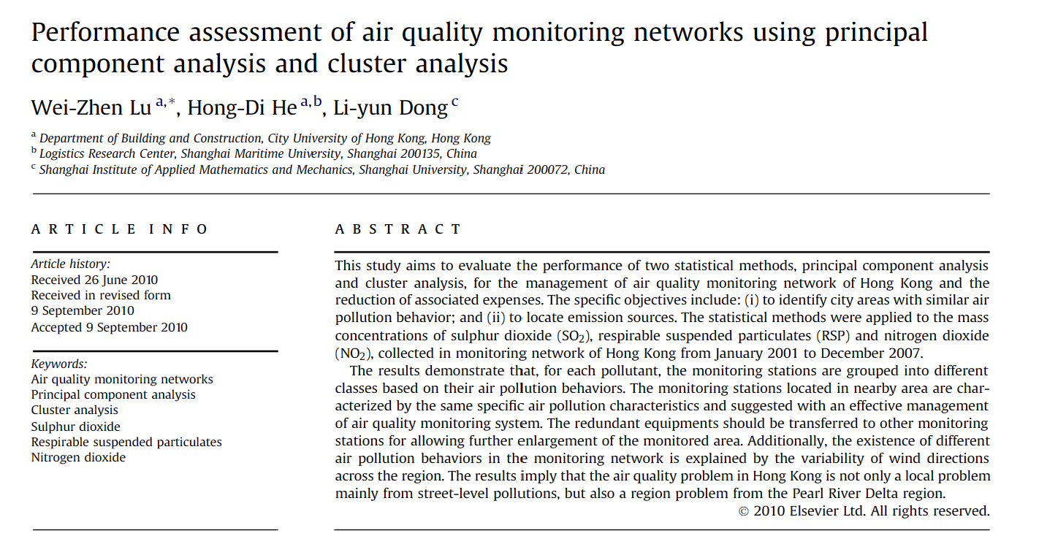
cluster analysis
DOI:10.1016/j.buildenv.2010.09.004
To investigate if device network are represenstative /correct for the site

Slide 7
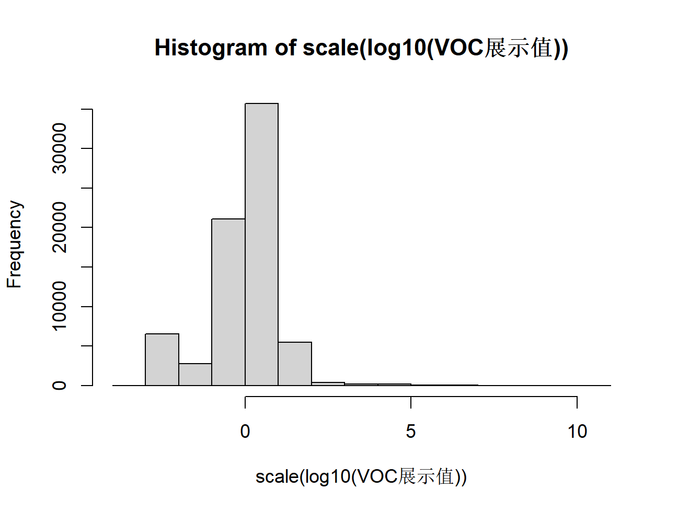
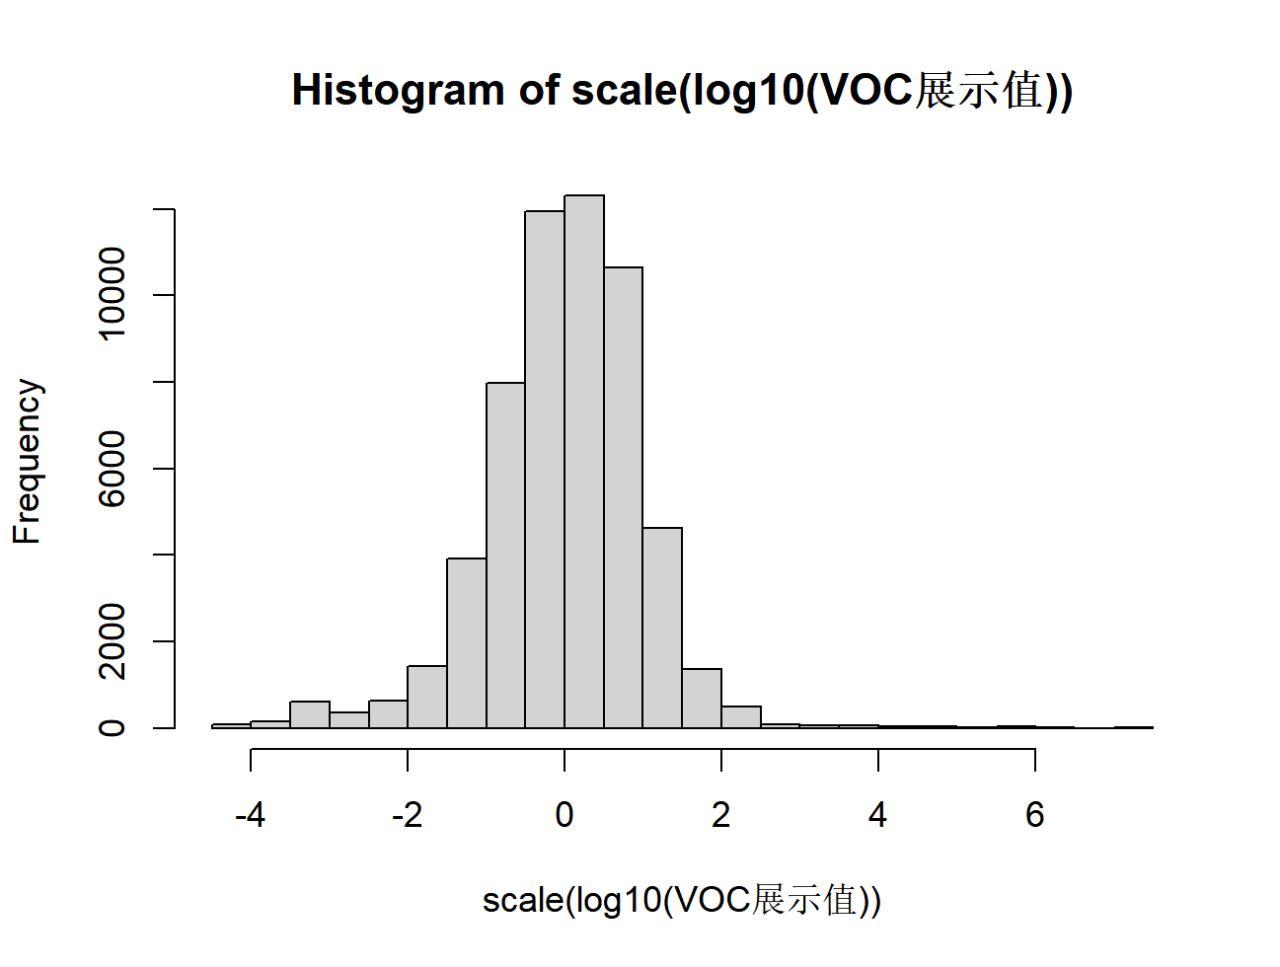
Comparasion of processed and unprocessed
2022 Dec all data in ZK
without deleting invalid data
deleted invalid data
Yes now is normal distribution!

Slide 8
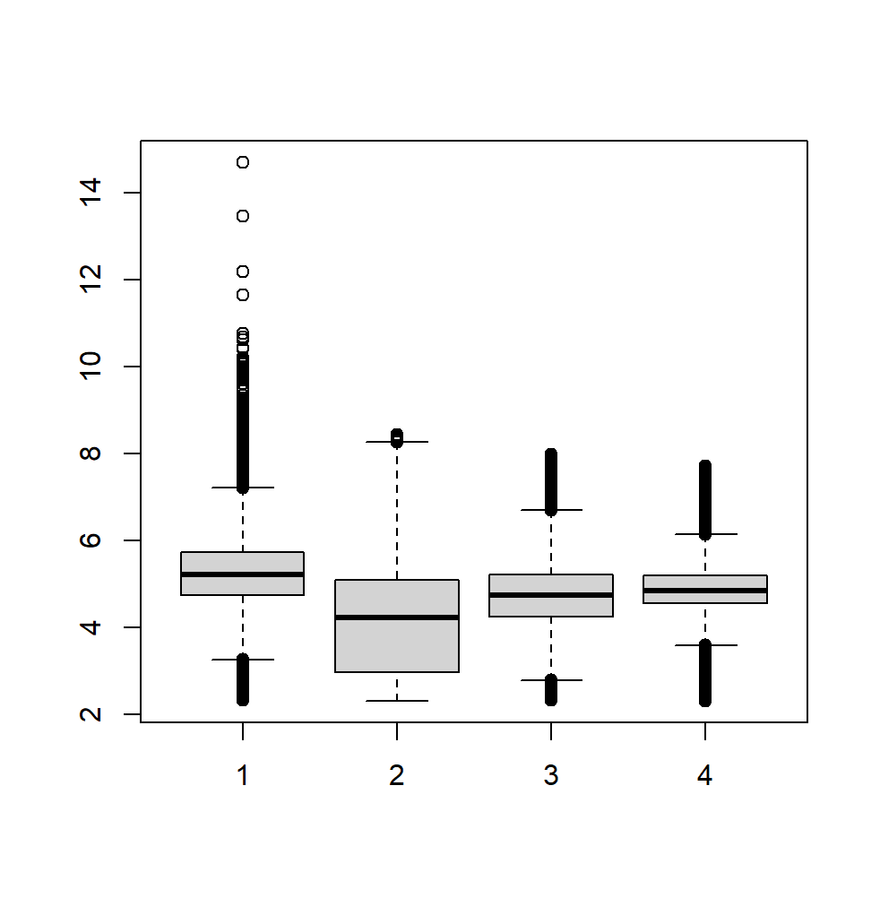
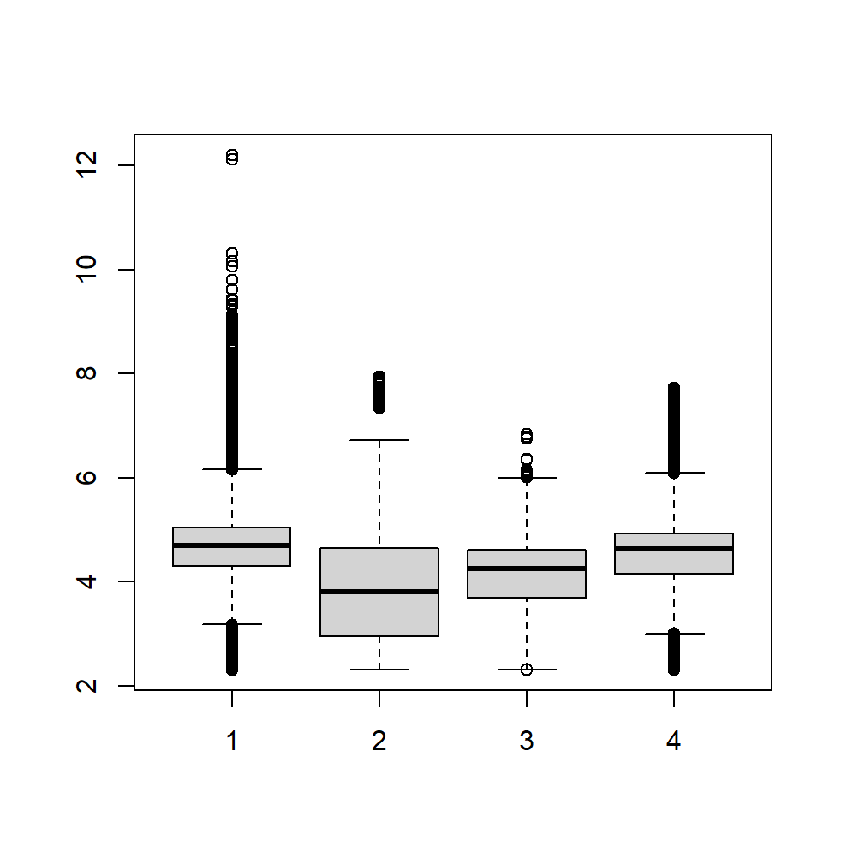
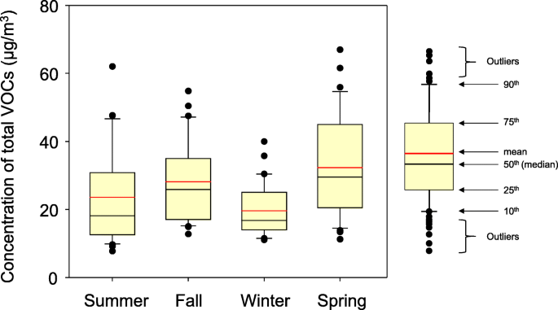
Graph to put (Logic of the Article)
monthly/seasonly emission pattern (using overall site average for each city)
Notes:
要有对象，VOC；VOC传感器；短语要构成核心思想；提出问题和挑战。从散到有组织状态（直奔主题，能解决无组织问题）——为什么能解决——为什么现在的不行——如何做出能行的。

Slide 9
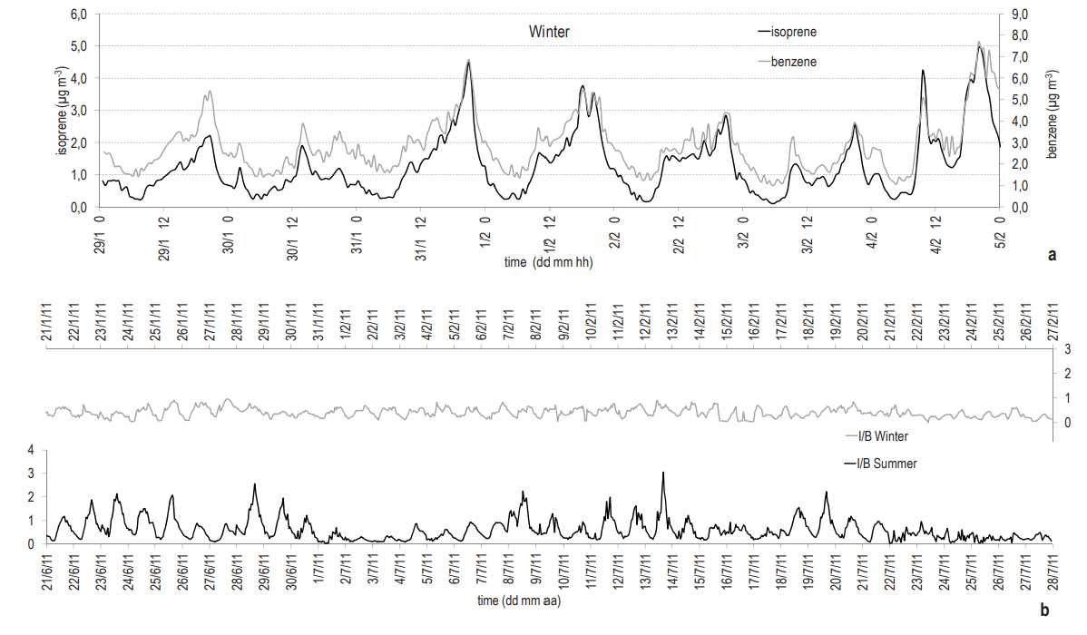
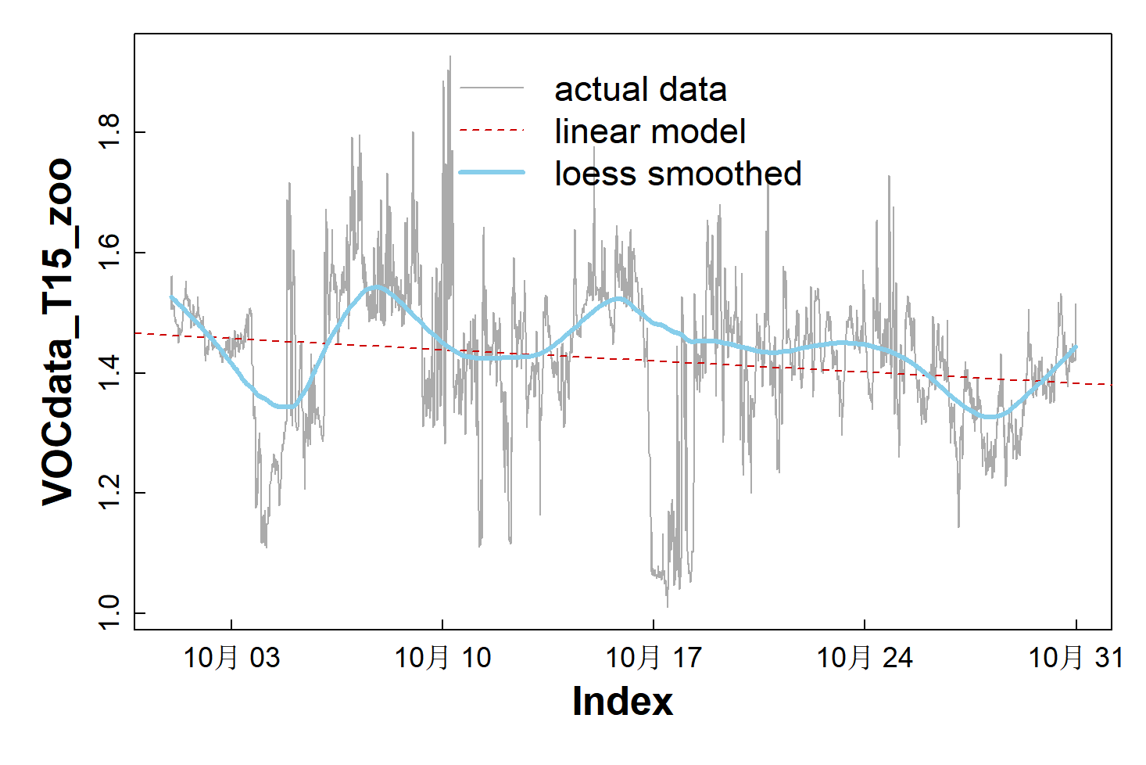
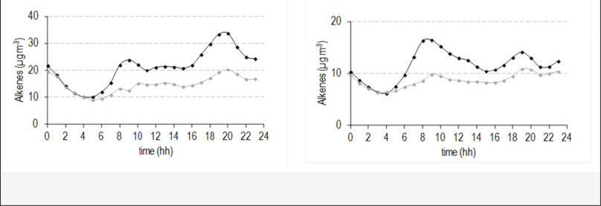
Graph to put (Logic of the Article)
time series analysis for each place
Monthly variation
eg. No.70 in 2022 Dec
Daily (from one year hourly average) variation

Slide 10
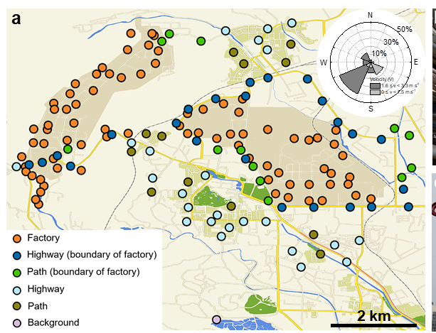
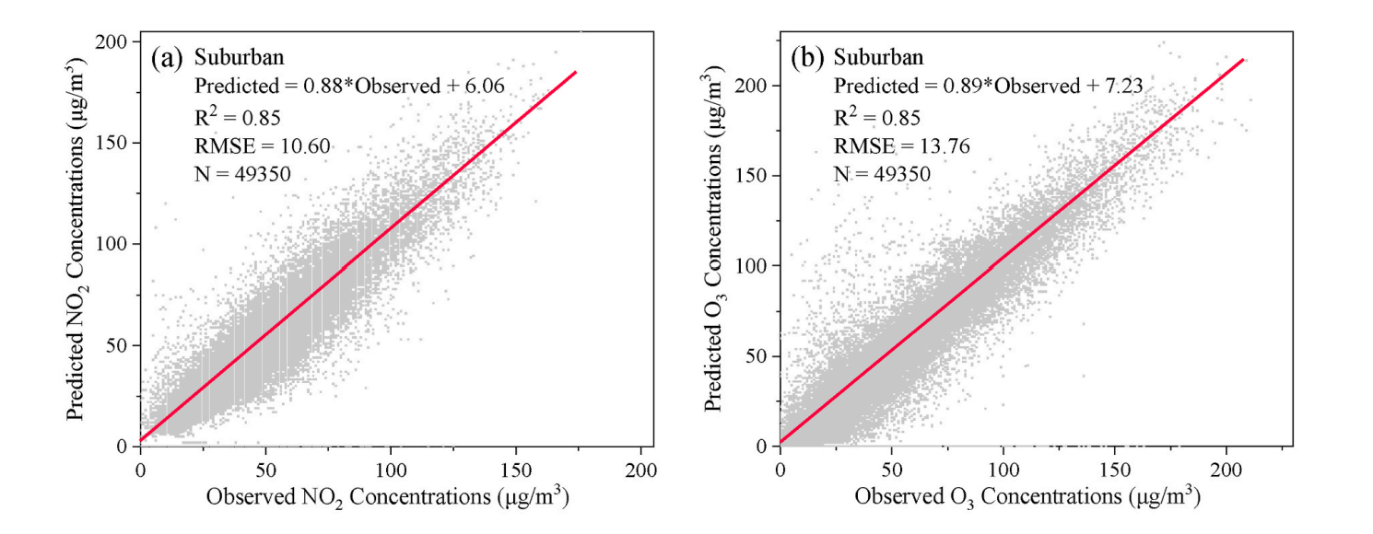
Graph to put (Logic of the Article)
AERMODE simulation (using seperate point,)
Initial emission in a representative point/day ( Combined with land type and background information)
AERMODE simulated emission after 1 hour/day
R² comparasion

Slide 11
Plan
plan before Andrew’s back
draft for intro/method/data presentation/discussion
emession distribution plot/staistical test/regression
distribution pattern-source/geological/local
plot to visualise
At the same time, chose a representative day in each season, run the model/plot- google earth

Slide 12

Acknowledgements
Collaborator:
TC Air Technology Co., Ltd
Prof. Zehui Li (Shanghai Jiao Tong University)
Notes:
要有对象，VOC；VOC传感器；短语要构成核心思想；提出问题和挑战。从散到有组织状态（直奔主题，能解决无组织问题）——为什么能解决——为什么现在的不行——如何做出能行的。

Slide 13
Thank you for your listening！
Email: andrew.rate@uwa.edu.au
21820087@student.uwa.edu.au
Notes:
要有对象，VOC；VOC传感器；短语要构成核心思想；提出问题和挑战。从散到有组织状态（直奔主题，能解决无组织问题）——为什么能解决——为什么现在的不行——如何做出能行的。

